Slide 1


Parent Workshop

Slide 2
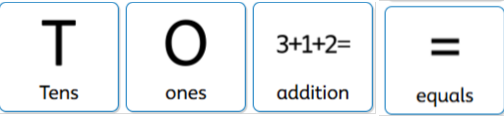
LO: To use column addition to add 2 digit numbers.
LC: Determined
Steps to Success
I can make the numbers using dienes.
I can line up the digits in the tens and ones columns
I can start adding from the ones column
I can check if I need to regroup.
I can add the digits in the tens column

Slide 3
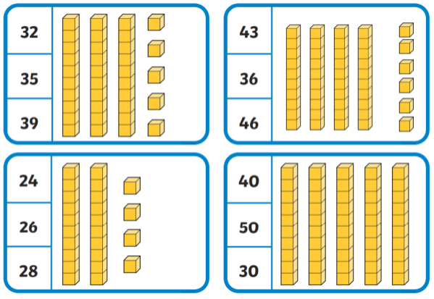
What number do the dienes represent?
Starter

Slide 4
What number do the dienes represent?
Starter

Slide 5
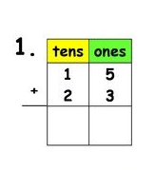
What is column method and why do we use it?
We teach the column method to help develop a secure understanding of place value — knowing that the value of a digit depends on its position in a number (for example, 3 means 3 ones in 23 but 3 tens in 30).
The column method supports this by:
Helping children see the value of each digit
Reinforcing that numbers are made up of tens and ones, not just separate digits
Making it clear why regrouping happens,
Notes:
Let’s go through some examples and you will see how using manipulatives helps children understand the value of the numbers .

Slide 6
What is column method and why do we use it?
Column method supports children’s learning through concrete, pictorial, and abstract (CPA) approaches:
Concrete: Children use physical objects, such as counters to represent the numbers.
Pictorial: Children draw pictures or place value representations to show what is happening when numbers are added.
Abstract: Children then record the calculation using numbers and symbols in columns.

Slide 7
Key Vocabulary
Today, we will be using the deines to help us understand more about place value and how we can set out our column addition calculations correctly.

Slide 8
Let’s watch a video to help us understand
https://www.youtube.com/watch?v=bqclSAMRiV0

Slide 9
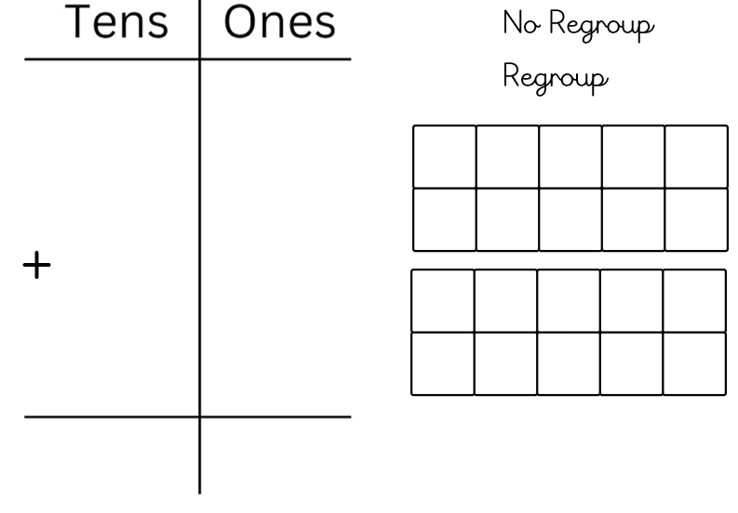
11 + 14 =
I do
1
1
1
4
Steps to Success
I can line up the digits in the tens and ones columns
I can make the numbers using dienes.
I can start adding from the ones column
I can check if I need to regroup.
I can add the digits in the tens column

Slide 10
11 + 14 =
I do
1
1
1
4
Steps to Success
I can line up the digits in the tens and ones columns
I can make the numbers using dienes.
I can start adding from the ones column
I can check if I need to regroup.
I can add the digits in the tens column
2
5

Slide 11
21 + 13 =
We do
2
1
1
3
Steps to Success
I can line up the digits in the tens and ones columns
I can make the numbers using dienes.
I can start adding from the ones column
I can check if I need to regroup.
I can add the digits in the tens column

Slide 12
21 + 13 =
We do
2
1
1
3
Steps to Success
I can line up the digits in the tens and ones columns
I can make the numbers using dienes.
I can start adding from the ones column
I can check if I need to regroup.
I can add the digits in the tens column
3
4

Slide 13
Your turn
Use the column method to solve addition problems.
Make your number using dienes.
Start adding the ones first.
Check if you need to regroup.
Add the tens.
C/C1 C2 C3
23 + 14
35 + 13
56 + 42
11 + 2
12 + 4
41 + 35

Slide 14
C/C1 C2 C3
11
+ 2
----
13
23
+14
----
37
56
+42
----
98
12
+ 4
----
16
35
+13
----
48
41
+ 35
----
76

Slide 15
Let’s watch a video to help us understand regrouping.
https://www.youtube.com/watch?v=lo1x-fENJwI

Slide 16
17 + 14 =
I do
1
7
1
4
Steps to Success
I can line up the digits in the tens and ones columns
I can make the numbers using dienes.
I can start adding from the ones column
I can check if I need to regroup.
I can add the digits in the tens column

Slide 17
17 + 14 =
I do
1
7
1
4
Steps to Success
I can line up the digits in the tens and ones columns
I can make the numbers using dienes.
I can start adding from the ones column
I can check if I need to regroup.
I can add the digits in the tens column

Slide 18
17 + 14 =
I do
1
7
1
4
Steps to Success
I can line up the digits in the tens and ones columns
I can make the numbers using dienes.
I can start adding from the ones column
I can check if I need to regroup.
I can add the digits in the tens column
3
1

Slide 19
Your turn
Use the column method to solve addition problems.
Make your number using dienes.
Start adding the ones first.
Check if you need to regroup.
Add the tens.
C/C1 C2 C3
13 + 18
34 + 17
32 + 28
12 + 9
18 + 3
47 + 35

Slide 20
C/C1 C2 C3
1 3
+ 1 8
--------
31
___
1
3 2
+ 2 8
--------
60
____
1
12
+ 9
----
21
____
1
1 8
+ 3
----
21
____
1
4 7
+ 3 5
--------
8 2
_____
1
3 4
+ 1 7
------
51
____
1

Slide 21
A reasoning question.
CT to model on flipchart
Using column method to solve addition problems.
Mrs Kelly is playing a game.
A is equal to 12 points.
A is equal to 25 points.
A is equal to 14 points.
She got a star and a triangle.
What is the total number of points she got?
Notes:
Reasoning in maths is making logical links and connections which help you tackle a new problem.

Slide 22
Your turn
A reasoning question
Aarin and Thomas were playing football on their Nintendo. Aarin scored 22 goals on Monday and 13 on Tuesday.
Thomas scored 16 goals on Monday and 23 on Tuesday.
Who scored the most goals?

Slide 23
Plenary
Column methods are used to:
1. It supports place value understanding
2. It prepares children for larger numbers
3. It develops accurate calculation skills
4. It encourages logical thinking
5. It builds confidence and independence
Notes:
Writing numbers in columns helps children clearly see tens and ones. This makes it easier for them to understand why numbers add up the way they do, rather than just memorising steps.
The column method works for small numbers and continues to work for hundreds, thousands, and beyond. Learning it early means children won’t need to relearn a new method later.
By lining numbers up correctly, children are less likely to make mistakes. This is especially important as calculations become more complex.
Children learn to work step by step, making their thinking clear and organised. This helps teachers spot misunderstandings and support children more effectively.
Once children understand the structure of the method, they can solve problems on their own and explain their reasoning.

Slide 24
Application of Column method in year 6
A school is raising money for charity.
On Monday, they raised £4,785.
On Tuesday, they raised £6,948.
On Wednesday, they raised £5,367.
a) How much money did the school raise altogether?
b) The school’s target was £17,000. Did they reach the target?
c) Explain why using the column method is a sensible strategy for this calculation.
Notes:
Why this works well for column method
The numbers are large and not easy to add mentally
There are three addends
It involves regrouping (carrying)
Part (c) checks reasoning and method choice, not just the answer

