Slide 1

Music
Mrs Tash

Slide 2






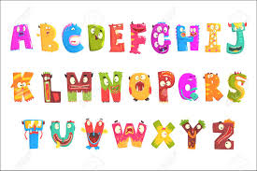




Why Learn Music?
Good for the brain
Perseverance
Language/Maths
Listening/ Concentration skills

Slide 3
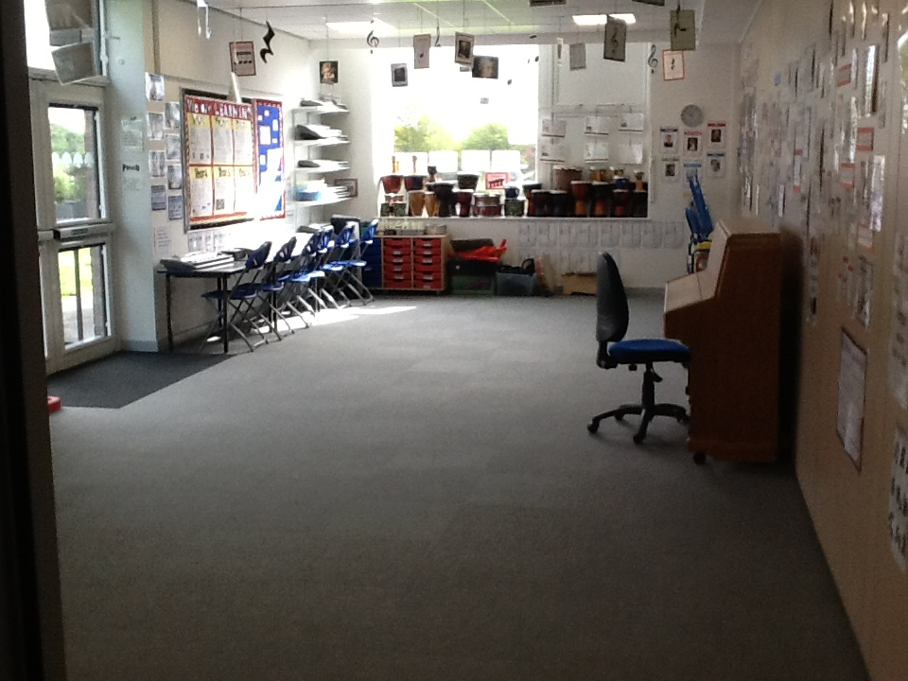
The Music Room
Children have weekly lessons
EYFS/KS1 – 30-40 mins
KS2 – 45mins – 1 hour

Slide 4
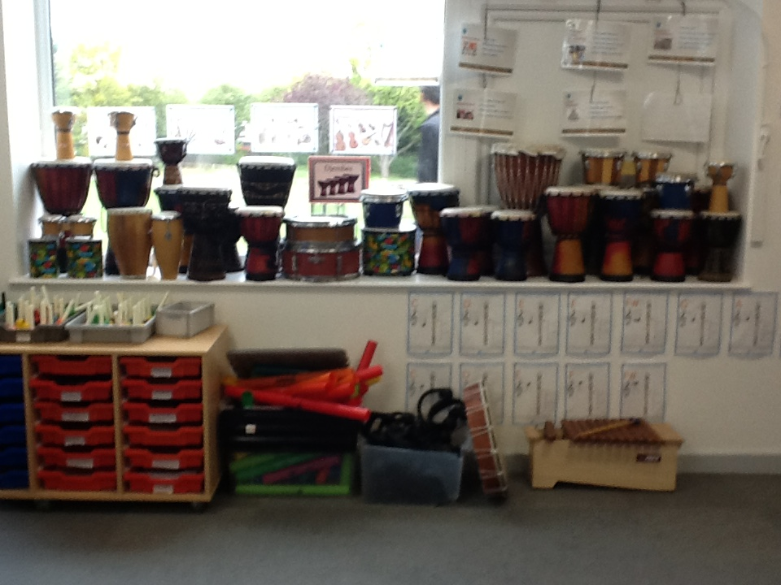
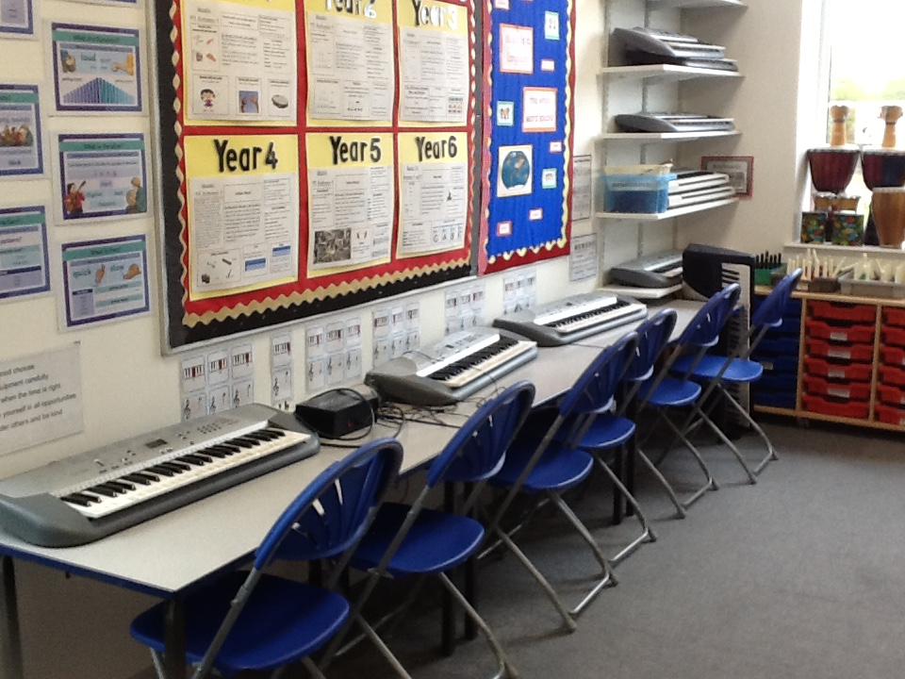
Instruments
Drums
Keyboards
We have many different kinds of instruments at Aylward

Slide 5
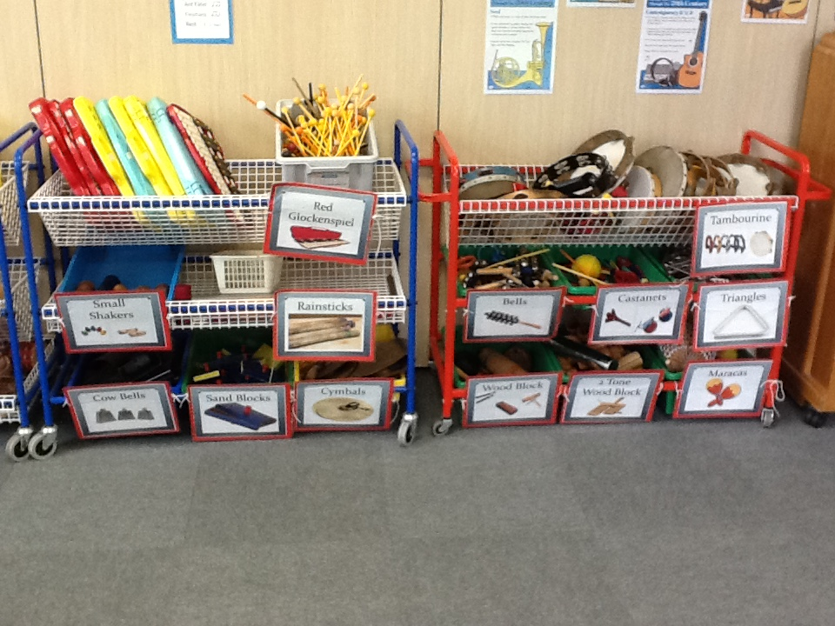
Instruments
Children learn the names of instruments, how they sound

Slide 6
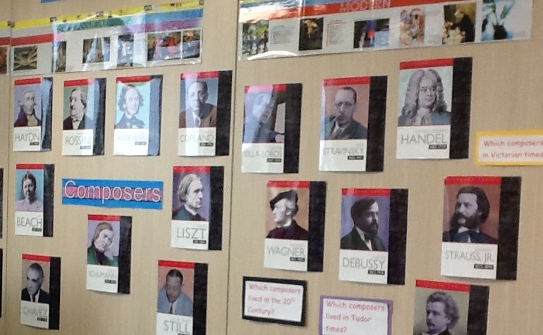






What do we learn?
Singing
Composers and the history of music
Reading music using musical notes and symbols
Listening and responding to music
Composing music

Slide 7
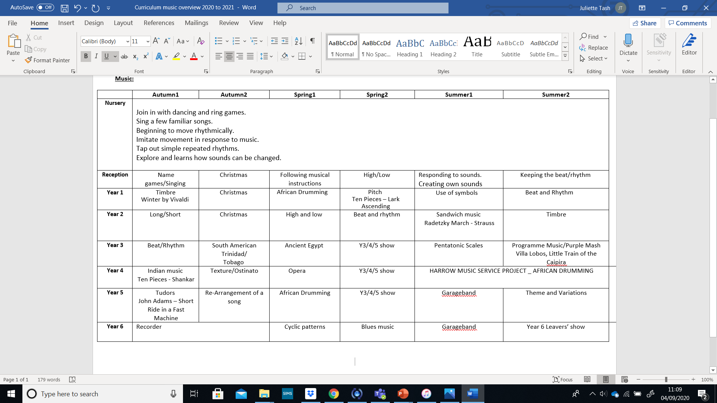
Overview
Here is what the children will be learning over the year

Slide 8
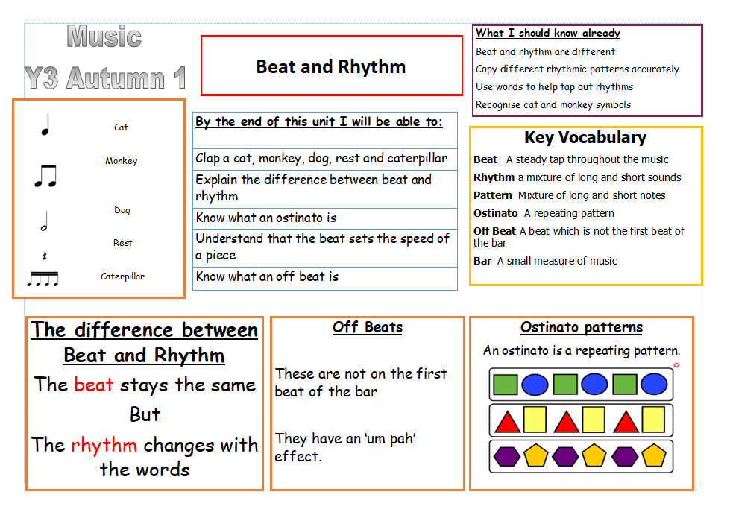
Knowledge Organisers – look out for them

Slide 9


Clubs
There are many clubs at Aylward. Children have the opportunity to join them.
Choir
Orchestra

Slide 10

Instrumental
Lessons
We offer lessons from Year 3 onwards
Lessons cost £195 per year
Monday – Violin
Tuesday – Piano/flute
Wednesday - Guitar
Speak to the office or Mrs Tash if you are interested

Slide 11

Performances
There are many opportunities to perform. Every child will do this at least once in the year.
Christmas – EYFS/KS1 Y 3/4/5 – March/April Y6 - Summer

Slide 12

REMEMBER…….

